Slide 1
Local health inequities tied to air pollution in Austin
Sarah Chambliss, MSE PhD
Research Associate, Department of Population Health
The University of Texas at Austin Dell Medical School
Co-authors: RA Zárate, Elizabeth Matsui, Corwin Zigler
NIH funding: R01ES034803

Slide 2


Connecting Environment to Health in Texas & Beyond
CHEER is a hub for multidisciplinary environmental health sciences research and education. The center brings together experts from the Cockrell School of Engineering, College of Natural Sciences, College of Pharmacy, Steve Hicks School of Social Work, Jackson School of Geosciences and Dell Medical School at The University of Texas at Austin.
Director: Elizabeth Matsui, MD, MHS
Steering Committee: Catherine Cubbin, Lydia Contreras, Andrea Gore, Kerry Kinney, Roger Peng, Geeta Persad, Susan Balcer Whaley, Corwin Zigler

Slide 3
Insights from INHALE: Inequitable Neighborhood Health and Airborne Lung Exposures.
The INHALE study, supported by a grant from NIH NIEHS, is a multidisciplinary investigation into the interrelationships between air pollution, health disparities, and urban planning. We investigate how racial and ethnic disparities in asthma morbidity in Austin and across the state of Texas are linked to urban planning policies that resulted in exposure to more, and more toxic, sources of air pollution.

Slide 4
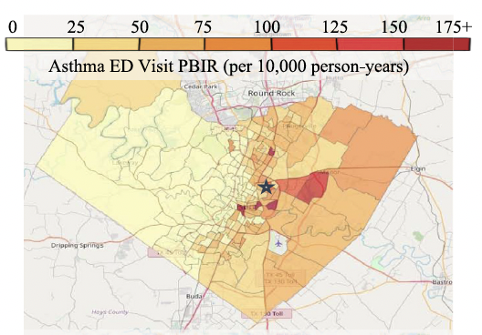
Why are there more asthma ED visits from East Austin?
Zárate et al., JACI 2024
What Emergency Department visits indicate:
Higher rates of asthma across the neighborhood
× more uncontrolled asthma incidents per person
Relationship with race and ethnicity goes beyond differences in
  socioeconomic status (% of household with below-poverty income, educational attainment)
  related housing factors (crowding, types of housing)
  healthcare access (insurance, car ownership)

Slide 5
What is the role of air pollution?
What kinds of air pollution are
worst in different parts of Austin?

Slide 6
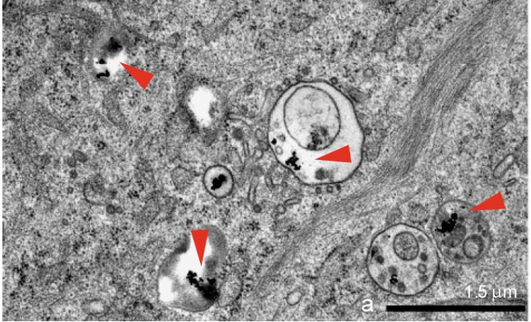
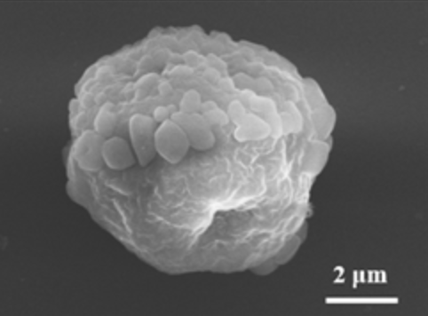
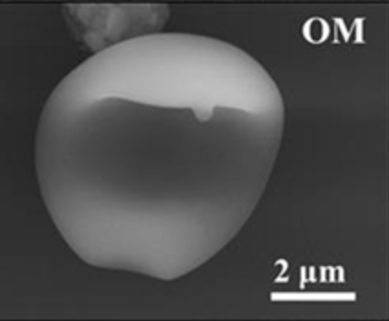
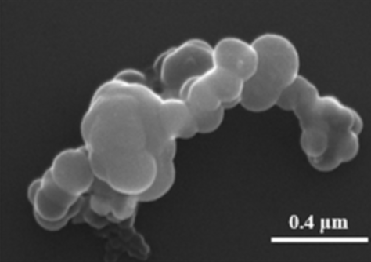
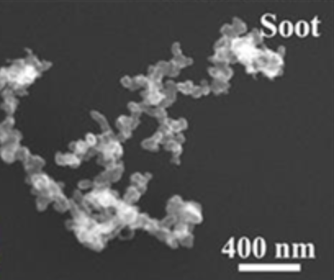
Particulate matter: diverse composition, formation, sizes, and behavior
All particles on approximately
the same scale
Ultrafine particles within human fibroblast cells, Madl and Majid 2011
SEM images Li et al. 2016
Background

Slide 7
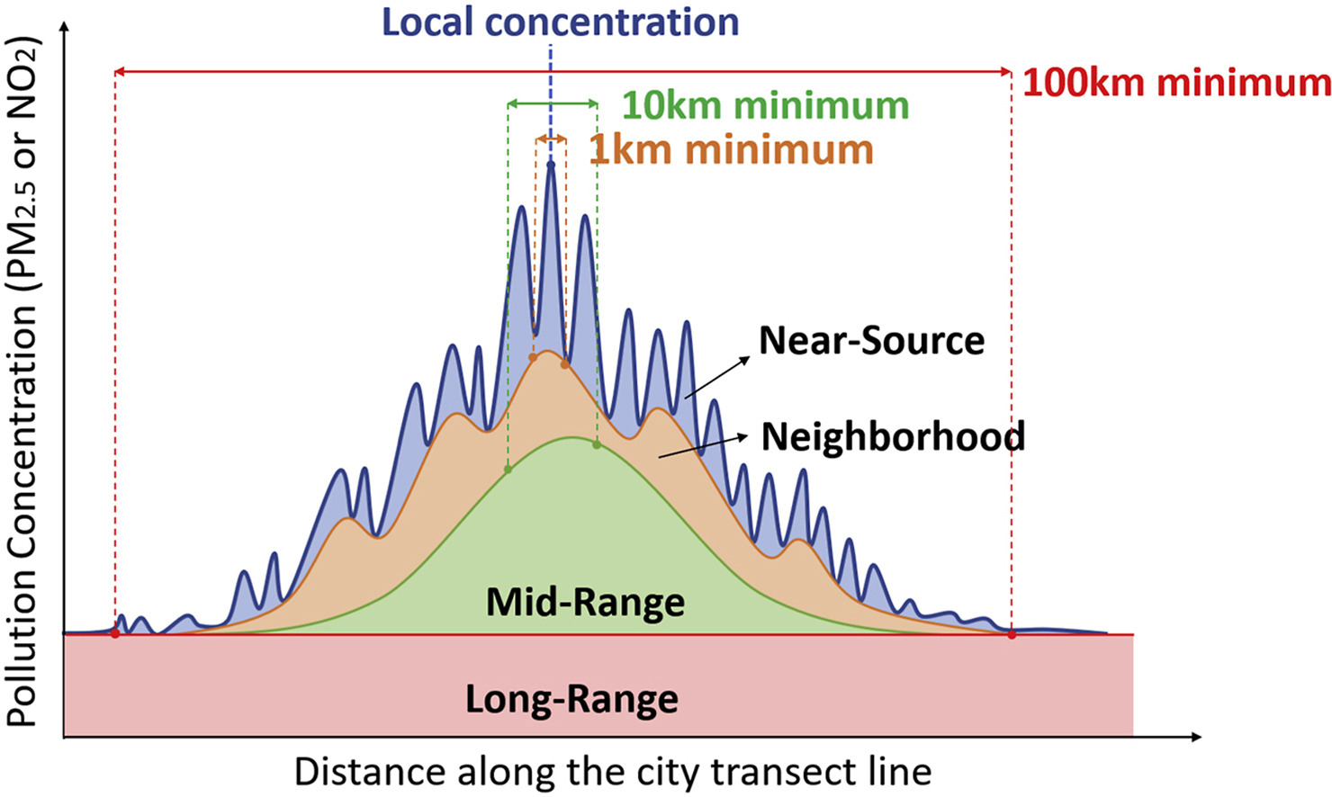
Spatial patterns depend on background levels and distance from emission sources
Wang et al. 2020

Slide 8
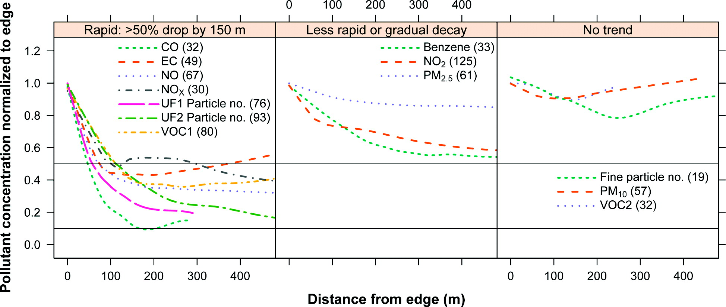
Pollutant characteristics and sources determine spatial patterns and potential impacts on health disparities
Karner et al. 2010
Background

Slide 9
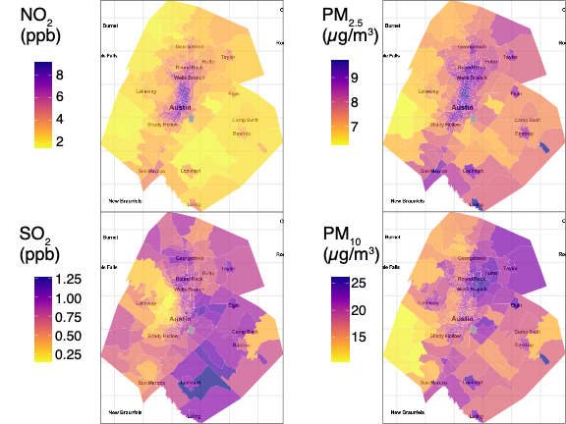
Mostly from traffic
Traffic + other fuel burning + local industry
Air pollution modeling by Kim et al. (2020) PLOS ONE
Large sources + power plants + landfill biogas
Road dust + construction-related fly-away dust

Slide 10
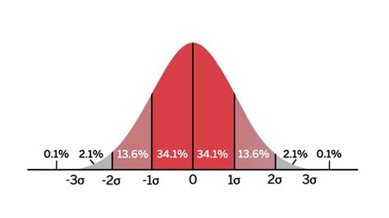
How is asthma linked to outdoor air pollution in Austin?
For one “standard deviation” difference:
For fine PM: 22% more asthma visits
For coarse PM: 30% more asthma visits
For sulfur dioxide: 32% more asthma visits

Slide 11
How can we deal with the complex interconnections between air pollution, health, and race/ethnicity?
Some statistical approaches can lend clarity, although do not provide definitive answers.
Notes:
- Use a series of statistical tests to look at the relationship between

Slide 12
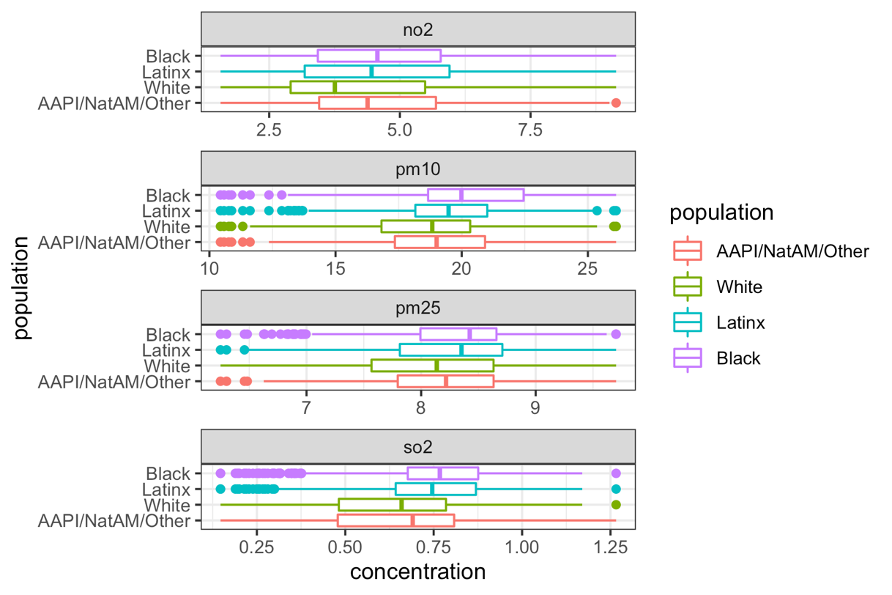
Do air pollution levels within the Austin metro area share patterns with race and ethnicity?
Even after factoring out other income-related details
Higher share of Black residents, higher concentrations:
  coarse PM (related to road + construction dust)
  sulfur dioxide (related to large industrial operations)
Higher share of Latinx residents, higher concentrations:
  coarse PM (related to road + construction dust)
  fine PM (related to all kinds of fuel burning and local sources)

Slide 13
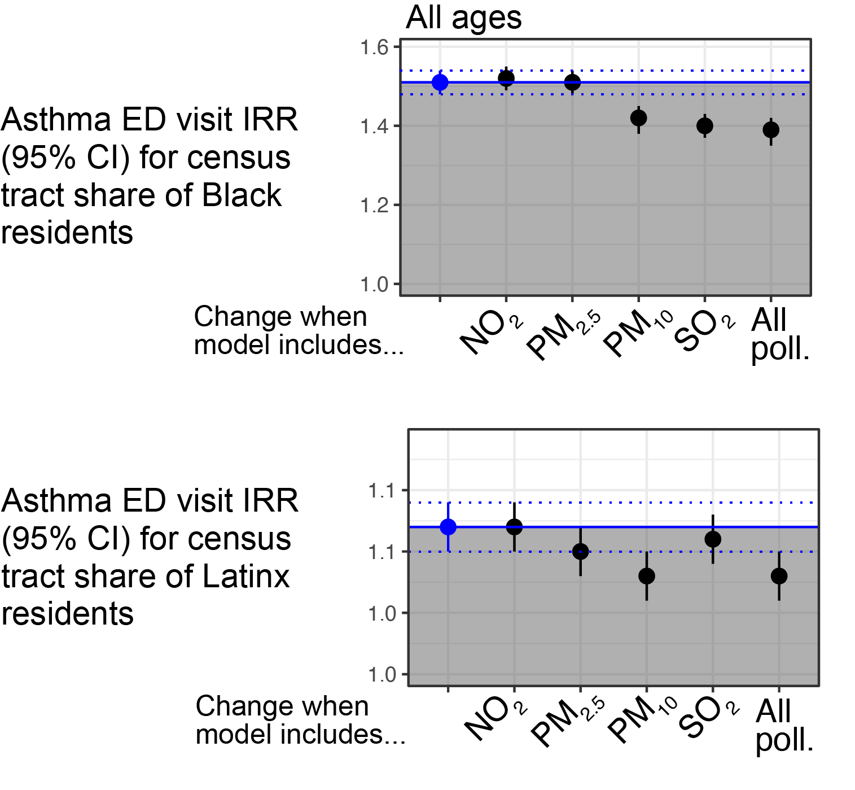
What do asthma differences by race and ethnicity look like after “factoring out” air pollution?
After factoring out air pollution:
39%
Asthma inequity:
51%
After factoring out air pollution:
8%
Asthma inequity:
12%

Slide 14
Where do we go from here?
Investigate health impacts of specific types of air pollution sources
  Supporting findings:
    Interactions between PM and other pollutants in predicting health impacts
    Pollutants show independent effects, different pollutants matter for different racial/ethnic grousl
Examine the factors leading to the location of polluting sources in neighborhoods with more people of color

